Slide 1
„ZPR PWr – Zintegrowany Program Rozwoju Politechniki Wrocławskiej”
Business cycle

Slide 2
Business cycle
Business cycle is the sequence of following periods of economic growth and crises, affecting the whole range of economic activities.
Conclusions:
Business cycle influence the whole economy (not just one or few sectors).
Periods of growth and crises follow each other

Slide 3
Business Cycle
A business cycle is a cycle of fluctuations in the Gross Domestic Product (GDP) around its long-term natural growth rate. It explains the expansion and contraction in economic activity that an economy experiences over time.
A business cycle is completed when it goes through a single boom and a single contraction in sequence. The time period to complete this sequence is called the length of the business cycle.
A boom is characterized by a period of rapid economic growth whereas a period of relatively stagnated economic growth is a recession. These are measured in terms of the growth of the real GDP, which is inflation-adjusted

Slide 4
Causes of business cycle
William Stanley Jevons points out that climatic conditions- good or bad create boom and depression
Pigou is of opinion that variations in business confidence and other psychological factors cause fluctuations in business.
Caused by innovations ( Schumpeter)
Under or over-consumption ( JA Hobson)
Non-monetary factors (Hawtrey)
Excess of investment over voluntary savings
Autonomous investment and induced investment(JR Hicks)

Slide 5
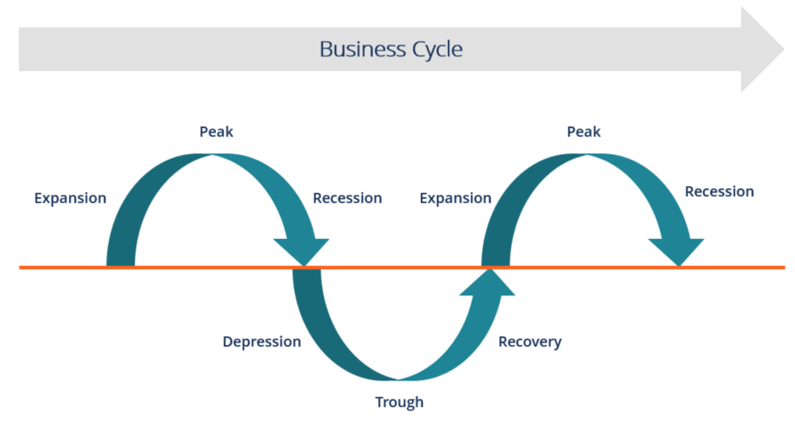
Business Cycle

Slide 6
Phases
We typically distinguish two phases
Expansion
Contraction
Phases are separated by
Trough: end of contraction
Peak: end of expansion

Slide 7
Stages of the Business Cycle
1. Expansion
The first stage in the business cycle is expansion. In this stage, there is an increase in positive economic indicators such as employment, income, output, wages, profits, demand, and supply of goods and services.
Debtors are generally paying their debts on time, the velocity of the money supply is high, and investment is high. This process continues as long as economic conditions are favourable for expansion.

Slide 8
Recovery or revival
It is a period wherein, economic activities receive stimulus and recover from the shocks.
Prosperity or full-employment – Full employment may be defined as a situation wherein all available resources are fully employed at the current wage rate.
According to Prof. Haberler “Prosperity is a state of affair in which the real income consumed, produced and the level of employment is high or rising and there are no idle resources or unemployment workers or very few of either.”

Slide 9
2. Peak
The economy then reaches a saturation point, or peak, which is the second stage of the business cycle. The maximum limit of growth is attained. The economic indicators do not grow further and are at their highest. Prices are at their peak. This stage marks the reversal point in the trend of economic growth.

Slide 10
3. Recession
The recession is the stage that follows the peak phase. The demand for goods and services starts declining rapidly and steadily in this phase. Producers do not notice the decrease in demand instantly and go on producing, which creates a situation of excess supply in the market. Prices tend to fall. All positive economic indicators such as income, output, wages, etc., consequently start to fall.

Slide 11
4. Depression
There is a commensurate rise in unemployment. The growth in the economy continues to decline, and as this falls below the steady growth line, the stage is called a depression.
https://www.youtube.com/watch?v=gqx2E5qIV9s

Slide 12
5. Trough
In the depression stage, the economy’s growth rate becomes negative. There is further decline until the prices of factors, as well as the demand and supply of goods and services, contract to reach their lowest point. The economy eventually reaches the trough. It is the negative saturation point for an economy. There is extensive depletion of national income and expenditure

Slide 13
6. Recovery
After the trough, the economy moves to the stage of recovery. In this phase, there is a turnaround in the economy, and it begins to recover from the negative growth rate. Demand starts to pick up due to low prices and, consequently, supply begins to increase. The population develops a positive attitude towards investment and employment and production starts increasing.

